Slide 1
Siamese Neural Networks for One-Shot Image Recognition
Indra Imanuel Gunawan / 20195118

Slide 2
Introduction
Machine learning has been able to perform image recognition with great performance
But the algorithm usually break down when little supervised information is available
The goal of the experiment is to generalize many data classes without necessitating extensive retraining
One of the task that want to be achieved through this experiment is one-shot Learning

Slide 3
Approach
In the experiment, we use character recognition as an example.
The network used is Siamese Convolutional neural network, which are able to:
Learn generic image features
Easily trained using standard optimization techniques
Deep learning techniques

Slide 4
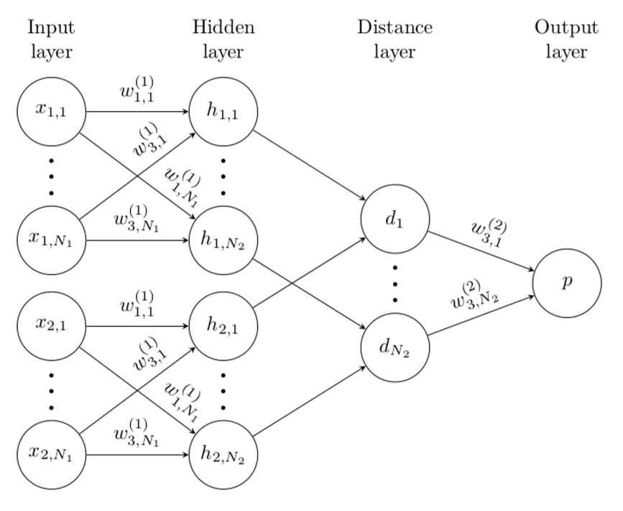
Siamese Network

Slide 5
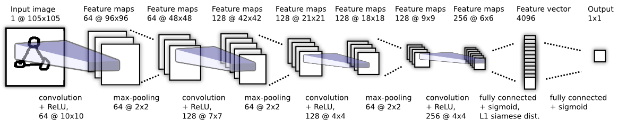
Model
Siamese Convolutional Neural Networks
Use ReLU units in the first L-2 layers and sigmoidal units in the remaining layers

Slide 6
How the model learns
Loss Function
Optimization
Weight Initialization
Learning Schedule
Affine Distortions

Slide 7
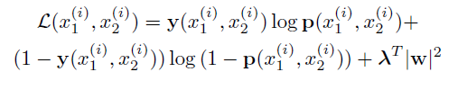
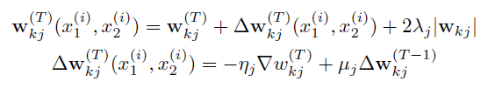
Learning
Loss function
Optimization

Slide 8
Learning
Weight and bias initialization
Convolutional layers:
Weight : Normal distribution with zero-mean and standard deviation of 10^-2.
Bias : Normal distribution with mean 0.5 and standard deviation of 10^-2
Fully connected layer:
Weight : Normal distribution with zero-mean and standard deviation of 2 x 10^-1
Bias : Initialized the same way with the convolutional layer

Slide 9
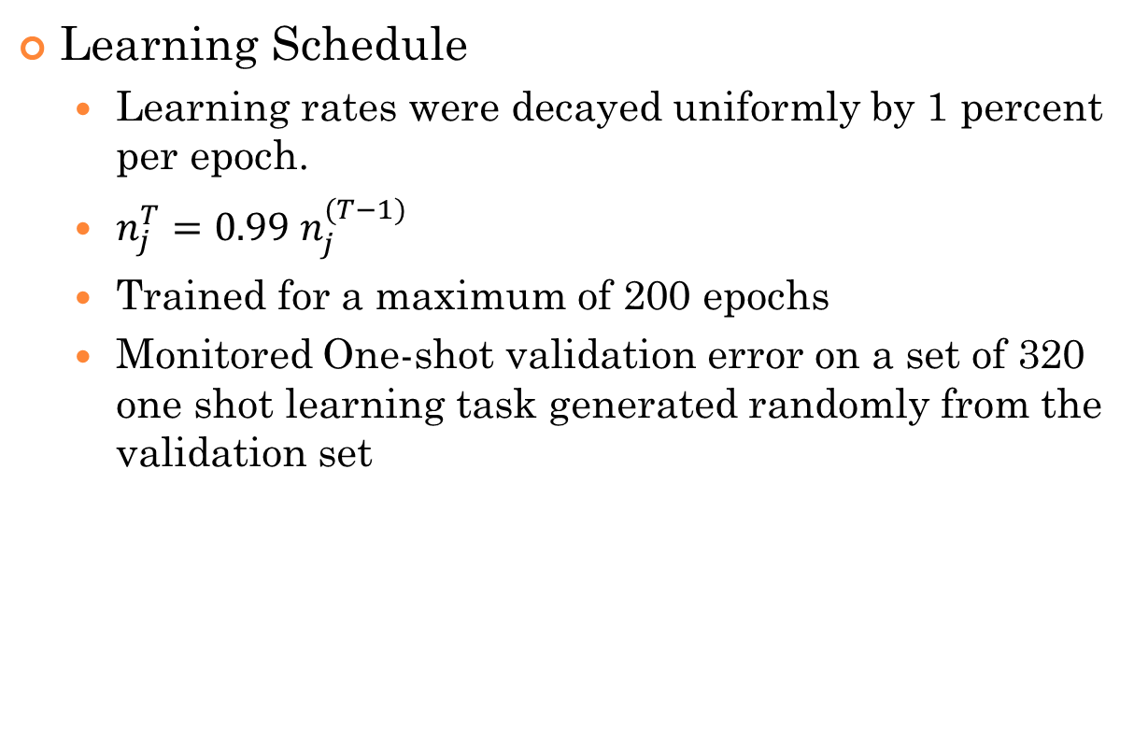
Learning
Learning Schedule
Learning rates were decayed uniformly by 1 percent per epoch.
$n_{j}^{T}=0.99 n_{j}^{(T−1)}$
Trained for a maximum of 200 epochs
Monitored One-shot validation error on a set of 320 one shot learning task generated randomly from the validation set

Slide 10
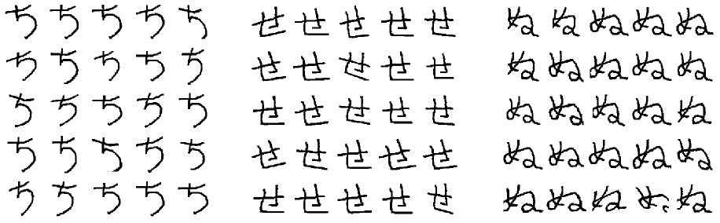
Learning
Affine Distortions

Slide 11
Experiments
Using Omniglot dataset
Verification
One shot learning

Slide 12
Omniglot dataset
Collected by Brenden lake and his collaborators at MIT
Contains examples from 50 alphabets, such as Latin, Korean, lesser known local dialects, and fictious characters sets (Aurek-Besh & Klingon)
Number of letters in each alphabet varies from 15 to 40 characters.
20 drawers who write all the characters single time
Lake split the data into 40 alphabet background set and 10 alphabet evaluation set

Slide 13
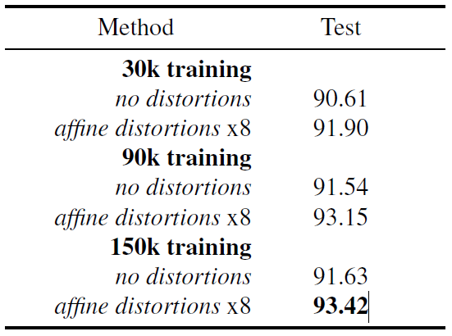
Verification
3 different dataset size : 30,000; 90,000; 150,000 by sampling random same and different pairs.
60% training data (30 out of 50 alphabets; 12 out of 20 drawers)

Slide 14
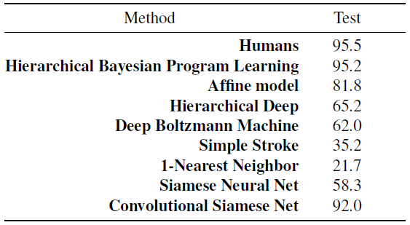
One shot learning

Slide 15
Conclusion
The network outperform all previous network for performing one shot classification.
Human level accuracy is possible
Can extend to another one shot learning task for image classification

Slide 16
References
Koch, G., Zemel, R., Salakhutdinov, R.: Siamese neural networks for one-shot image recognition. In: ICML 2015 Deep Learning Workshop (2015)
Bromley, Jane, Bentz, James W, Bottou, L´eon, Guyon, Isabelle, LeCun, Yann, Moore, Cliff, S¨ackinger, Eduard, and Shah, Roopak. Signature verification using a siamese time delay neural network. International Journal
of Pattern Recognition and Artificial Intelligence, 7 (04):669–688, 1993.

